Slide 1
Template
This is a template to help the candidates present their PhD proposal
The candidates are free to use it or not.
The slides and the presentation can be in french

Slide 2
Title of the PhD proposal
First name Last name of the candidate
PhD advisors : xxx
Host Laboratory

Slide 3
Education (30s-1mn)
Present your:
Curriculum (University XXX)
Background (Computer science; HCI; Social science, Ethics; etc. )

Slide 4
Previous achievements (2-3mn)
Present one (or max two) projects, typically the project related to your Master thesis.
Highlight :
Context / Problem
Objectives / Research Questions
Previous work & originality
Theoretical foundations / Approach / Methods
Solution
Evaluation / Validation
Impact (e.g. a publication, a demonstrator, etc.)

Slide 5
How did you understand your PhD topic
(about 3-5mn)
Context
You can describe typical scenario(s) involving collaboration between humans
Problem / challenges
Objectives / Research questions
Previous work / originality
How is your work related to previous work?
Theoretical foundations / Approach / Methods
Expected results
demonstrator, models, tools, guidelines, empirical findings, etc.
How to evaluate the impact of your PhD proposal on digital collaboration?

Slide 6
Why did you choose this PhD subject (30s-1mn)
Why did you choose this subject?
What do you like in this subject?

Slide 7
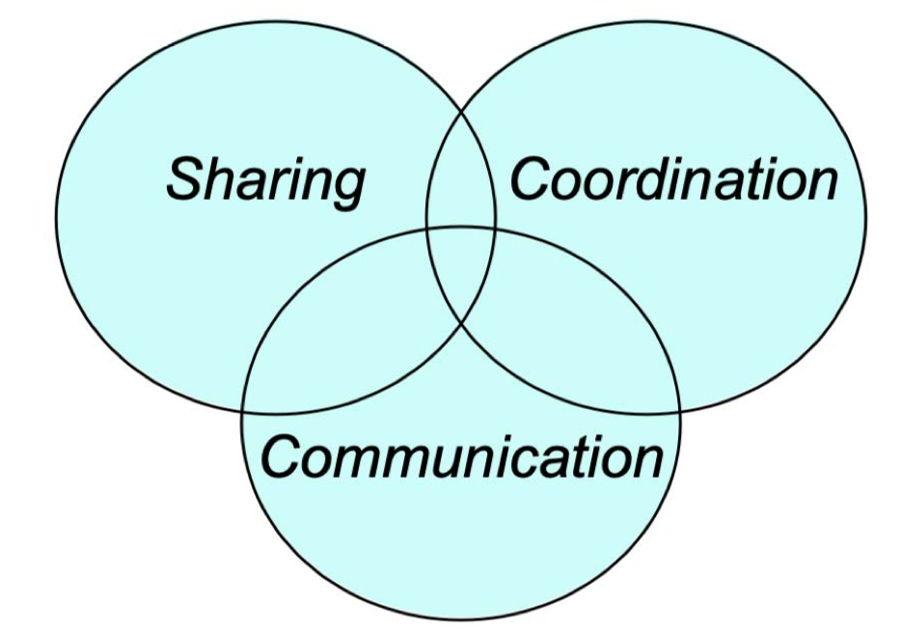
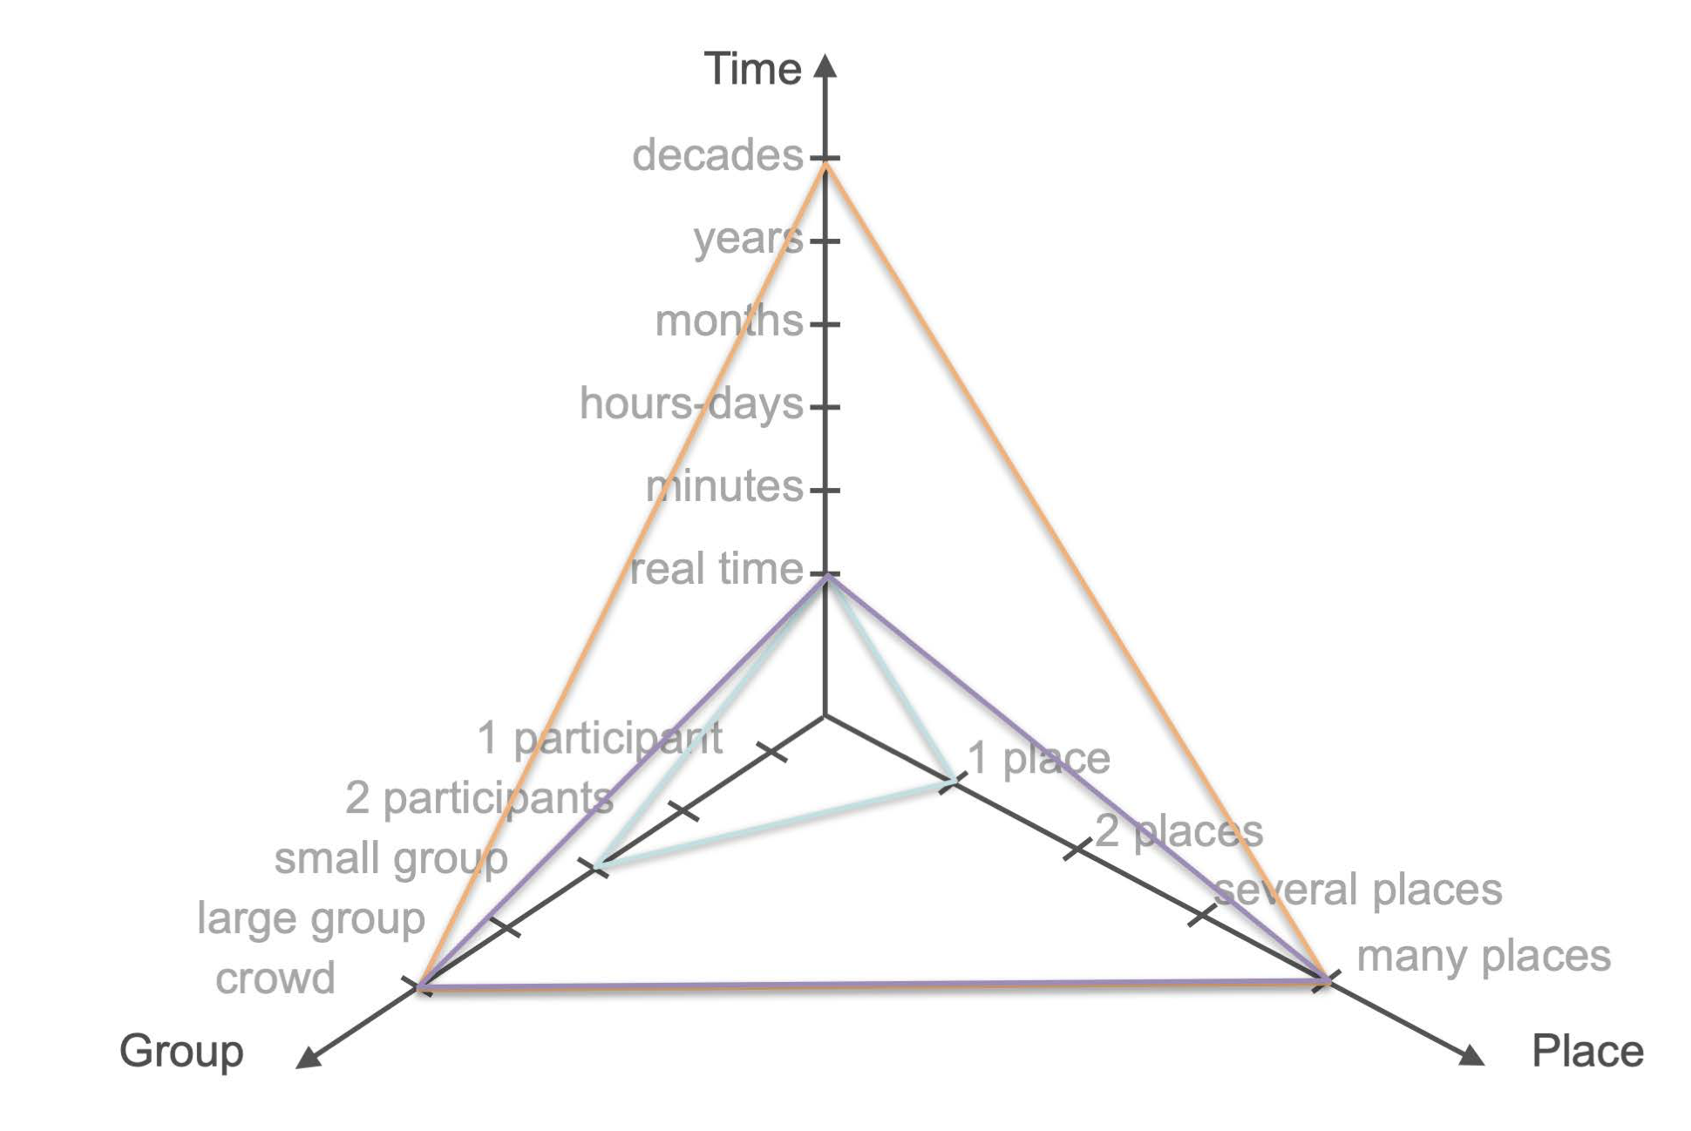
Integration into the PEPR eNSEMBLE (about 1mn)
What is the contribution of the PhD proposal regarding "Digital collaboration"?
For instance, you can use :
Functional taxonomy
Space-Time Matrix
Group-Time-Space continuum
etc.
How does your PhD proposal align with the scientific priorities of your Targeted Project (PC) or the other targeted projects (PCs)
Group-Time-Spacecontinuum
Functional taxonomy
Space-Time Matrix
Same
place
Different
places
Same
Time
Different
Times

Slide 8
Feasibility (1-2mn)
Is the environment (lab, team, etc.) appropriate for the PhD proposal?
Does your profile meet the requirements of the PhD proposal?
Are any skills missing?
Are they covered by the PhD advisors?
Is a specific training necessary / planned?

